Slide 1
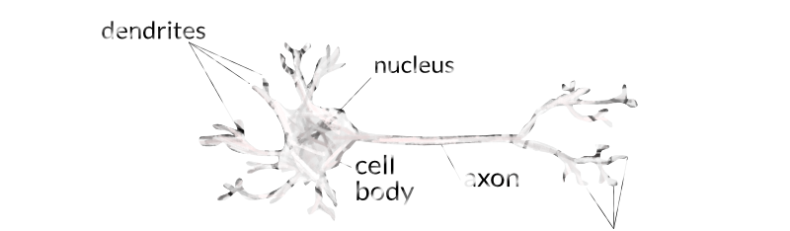
CLASSIFICATION
Perceptron – Binary Classification

Slide 2
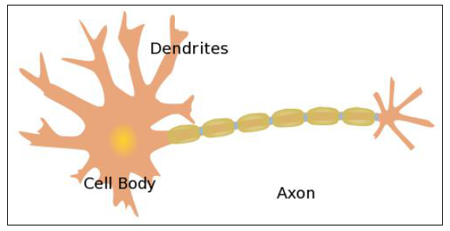
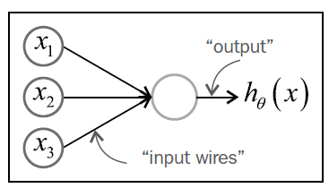
Primitive Neural network

Slide 3
Binary Classification using Perceptron
Y
X

Slide 4
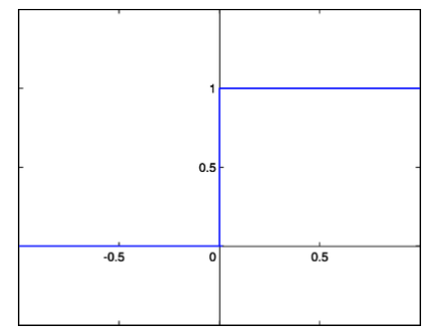

Perceptron Nodes
Heaviside Step Function
$$g\left(x\right)=\left\{\begin{matrix}1, if x>0 \\ 0 elsewhere\end{matrix}\right\}$$

Slide 5
Basic Two Input Perceptron
x₁
w₁
X1, X2 = Inputs
W1, W2 = Input weights
t = Threshold
= Activation Function)
Z = Output (Binary)
t
Output (Z)
x₂
w₂

Slide 6
Example 1
0.32
x₁
0.4
0.2
0.28
z
x₂
-0.2
-0.06
x₁
0.4
0.16
X1 | X2 | T
0.8 | 0.3 | 1
0.4 | 0.1 | 0
0.14
0.2
z
x₂
-0.2
-0.02

Slide 7
Problems
Y
Y
X
X
EXOR Function
Not Linearly Separable

Slide 8
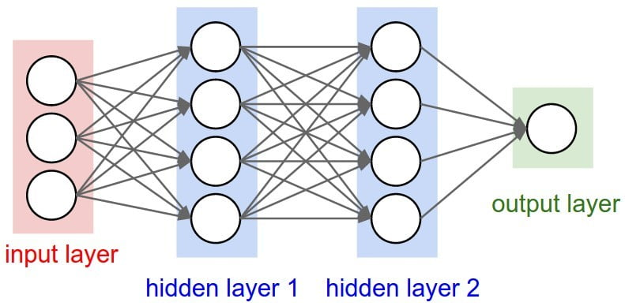
Neural Network

